Slide 1
Teaching Economics with Games
2/6/19
Alex Lamon
@AlexMLamon
Notes:
Games:
Fiscal Ship, Evolution of Trust, Chair the Fed, People’s Pie, Inflation Island

Slide 2
About Me
Teacher of business education in Livingston, NJ
Mock Trial teacher-coach
Council for Economic Education Master Teacher
National presenter
Organizer of eastern region business education

Slide 3
Today’s Goal
Today’s Goal: Showcase games and simulations, with best practice usage, for your CP or AP Economics classroom

Slide 4
What You’ll Leave With
Teachers will leave today with new games they can implement in their classrooms, understanding some of the pitfalls and peaks of these games as learning tools.

Slide 5
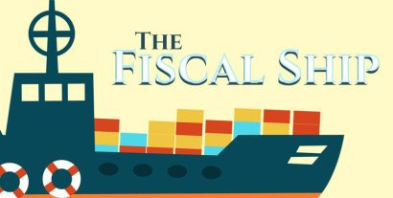
Game #1
Fiscal Ship
Topic: Fiscal Policy
Econ Ed Lesson
Teaching Resources

Slide 6
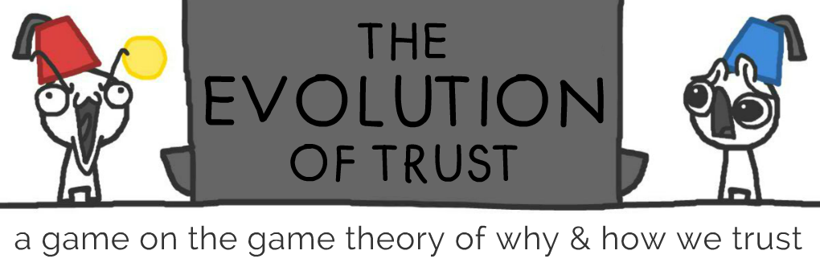
Game #2
Evolution of Trust
Topic: Game Theory
Background and context

Slide 7
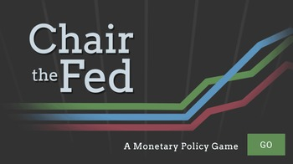
Game #3
Chair the Fed
Topic: Monetary Policy
FAQs / Reflection Questions
Video Question Guide

Slide 8

Game #4
People's Pie
Topic: Taxation
Player Guide

Slide 9
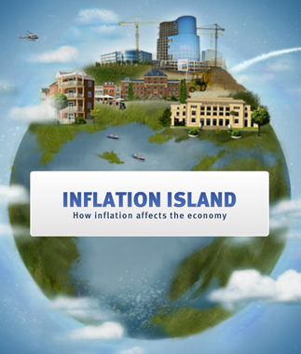
Game #5
Inflation Island
Topic: Inflation, Economic Indicators
Reflection & Assessment

Slide 10
Summary of Key Ideas
These games are tools to introduce or enhance understanding
Present them meaningfully, with a clear goal and purpose
Provide opportunity for all students to reflect

Slide 11

Thank you!
Thank you! Feel free to connect:
lamonteach@gmail.com
@AlexMLamon

